Slide 1
Simian Army
Janitor Monkey

Slide 2

What Janitor Monkey Do
Automatically cleanup the resources that are no more needed
Mark the resources
Notify the owners
Cleanup the resources
Notes:
根據某些規則 (RuleEngine) 決定怎樣的 Resource 算是 unneeded
跟 Owner 確認這些 Resource 真得不要了 (會給 termination time)

Slide 3
Hierarchy
JanitorMonkey
JanitorA
ResourceA1
ResourceA2
JanitorB
ResourceB1

Slide 4
Janitor Monkey
Opt in resources
Opt out resources
Notes:
Default 為 opt-in

Slide 5
Mark a resource
JanitorRuleEngine
Rule
Exclusion Rule

Slide 6
Abstract Janitor
markResources()
cleanupResources()
markedResources
unmarkedResources
cleanedResources
failToCleanResources
Notes:
unmarkedReource -> markResource() 裡面會以現在的 RuleEngine 檢查 trackedMarkedResources 裡面的 Resource 是否該 unmark; unmarkUserTerminatedResources()
最上兩個 operation 都定義為 run 的一種，每次 run 要開始時，最下四個 private attributes 都會 reset
canClean() -> 針對 markedResource, opt in, expire notification and termination time
Janitor Monkey 的 LOGGER 會用到最下四個 private attributes (getter)

Slide 7
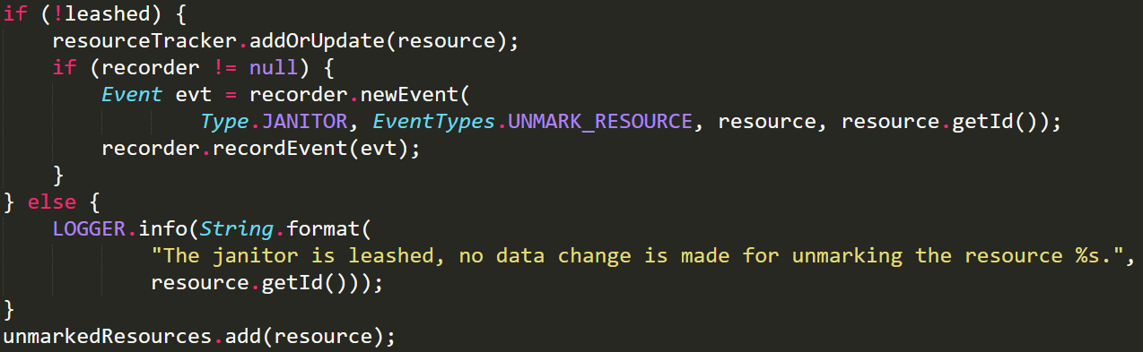
Abstract Janitor – flexibility
Leashed: boolean
JanitorResourceTracker
Notes:
Clean 的時候，是從 resourceTracker 抓 marked Resources
!leashed -> 修改 resourceTracker
不管有沒有 leashed，都修改 Janitor Monkey 的 LOGGER 會用到的那四個 private attributes (搭配 else 裡面的 log message 可避免 ambiguity -> 到底是 leashed 還是條件不符合)

Slide 8
Abstract Janitor – abstract operation
postMark()
cleanup()
postCleanup()

Slide 9
Class Diagram

